Slide 1

Tools for Families:
Partners in Supporting Our Children

Slide 2
Welcome
Patricia Wright
President of the Foundation for Educational Administration and Executive Director of the New Jersey Principals and Supervisors Association
Cathy Lindenbaum
President of the New Jersey Parent Teacher Association
Donna McInerney
CEO of the Foundation for Educational Administration
Jim Lukach
Executive Director New Jersey School Counselors Association

Slide 3
Family Experiences
OVERWHELMED!
  Teacher / Tutor
  Technology Expert / Challenges
  Parent
  Cook/Clean
  Still working / Lost job
  And the list goes on...

Slide 4
Sources of Strength
George Scott, Ed.S, LMFT
Statewide Resource Coordinator
Traumatic Loss Coalition

Slide 5
Today’s Challenges
Maintaining family health
Maintaining sense of order and routine
Children’s behavior
Managing fear and sadness
Enjoying time with your children
Staying connected to others

Slide 6
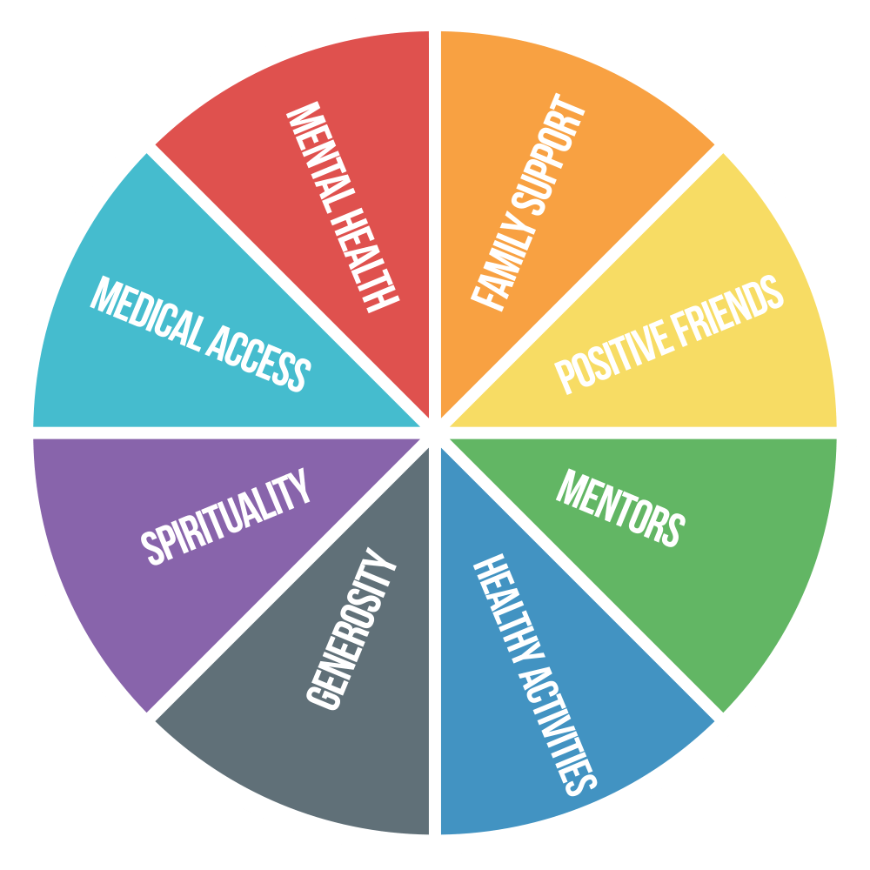
Sources of Strength
What strengths do you and your family have?
Identifying strengths
Building on strengths

Slide 7
Self Care for Parents
What do you currently do? Build on strengths!
Alone time
Physical activity and exercise
Reading
Outdoor time - walks, gardening, sitting in the sun
Sleep
Healthy eating
Other

Slide 8
Self Care for Children
Daily routines - bedtime, mealtime, school time, playtime/freetime
Enough sleep
Healthy eating
Movement and exercise
Virtual social time with friends

Slide 9

Establishing Routines
Four Pillars of Mental Health Routines:
Bedtime
Mealtimes
Work Time (school work, chores, etc.)
Play Time/Free Time

Slide 10
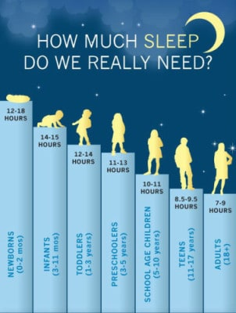
Sleep Routines
Plan the right amount of sleep
Establish time to go to bed and get up in the morning
Stick to bedtime routines
Limit access to media in the bedroom

Slide 11
Staying Calm
Find your calm then lend your calm
Children pay attention to how you react. How you react says more to them than what you say.
Learn to express not repress
Be positive and reassuring

Slide 12

Filter the Media
News
Social Media
Games
Too much exposure can be toxic - we absorb feelings and behaviors that we see

Slide 13
Pre-School and Elementary
Kaitlin Mulcahy, Ph.D.
Montclair State University

Slide 14
What is mental health in young children?
Enjoy relationships with caregivers and friends
Play by themselves and with others
Express emotions
Go to adults for comfort and be able to comfort themselves
Feel safe
Be curious

Slide 15
Tips for Helping Children During the Pandemic
Be available
Let them know they are safe
Teach your child things they can do to be safe
Create daily routines - build in family time
Limit exposure to news - share what kids need to know but not all you know

Slide 16
Be Available
• Being responsive to your child’s needs: “I see your body has some extra energy today. Do you want to go for a walk or have a dance party?”
• Listening to your child and talking about their feelings: “I know you feel disappointed that you can’t go to school to see your friends.”
• Answering questions: “She is wearing a mask because she is keeping us safe by covering her mouth.”

Slide 17
Let Them Know They Are Safe
• “The leaders in our community have made a plan for us to stay safe. I am going to help you be safe.”
• “We cannot go to grandma’s house right now, but we can Face Time her. She loves you so much, and that would make her so happy!”

Slide 18
Teach Children Things to Do to Be Safe and Be Helpful
“We are going to wash our hands for 20 seconds. This will get the germs that could make us sick off of our hands. What song do you want to sing?”
Show your child how to cover their cough.
Take positive action - bring food to food bank, make positive signs, create masks

Slide 19
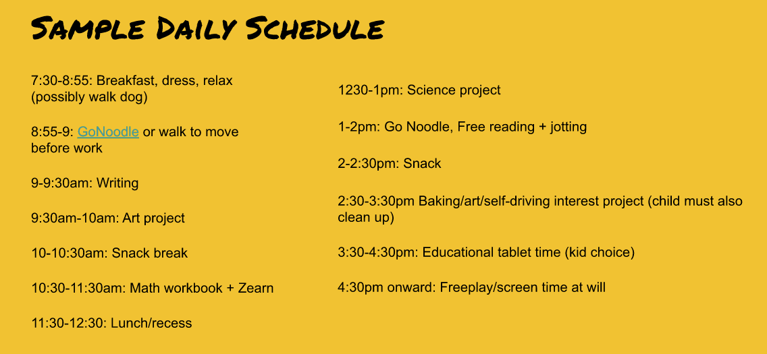
Create Written Daily Routines

Slide 20
Children’s Responses to Stress
Behaviors that challenge adults: What pushes your buttons?
Sleeping and eating problems
Agitation
Increase in conflicts
Physical complaints
Poor concentration

Slide 21
Challenging Behavior: Prevention
Use Positive Attention
Catch your child being good!
Use positive facial expressions such as smiles or funny faces.
Use descriptive praise: “You cleaned up breakfast all by yourself” or “Your brother looked so happy when you read the book to him.”
Give extra attention when they are good

Slide 22
Challenging Behavior: Prevention
Stick to routines
Let children know clearly what the rules are for behavior
Plan ideas ahead of time to keep them busy

Slide 23
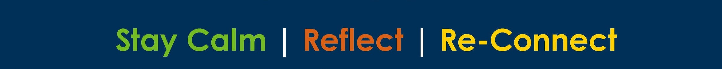
Handling Misbehavior
Is your child experiencing tantrums? Anger? Frustration?
The best approach is to remain calm or you can make it worse. Let’s look at steps to stay calm

Slide 24
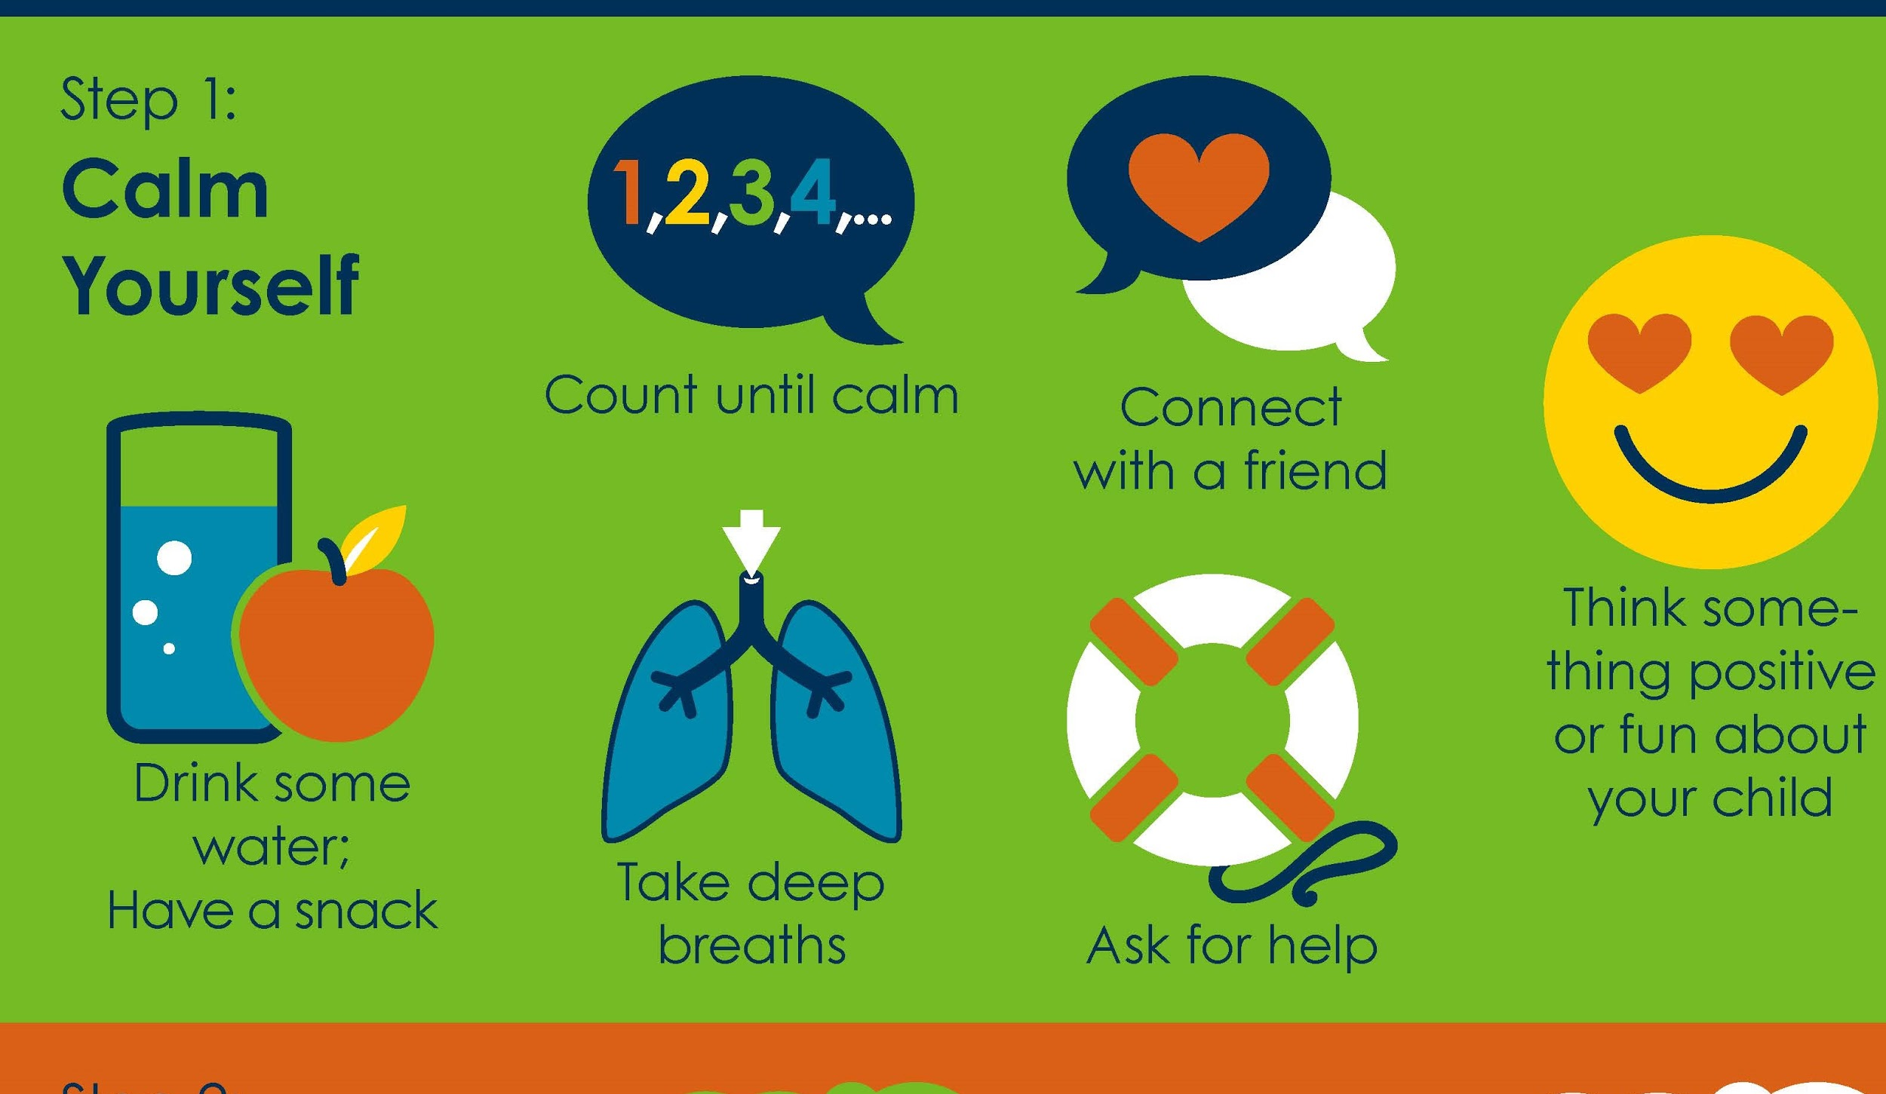

Slide 25
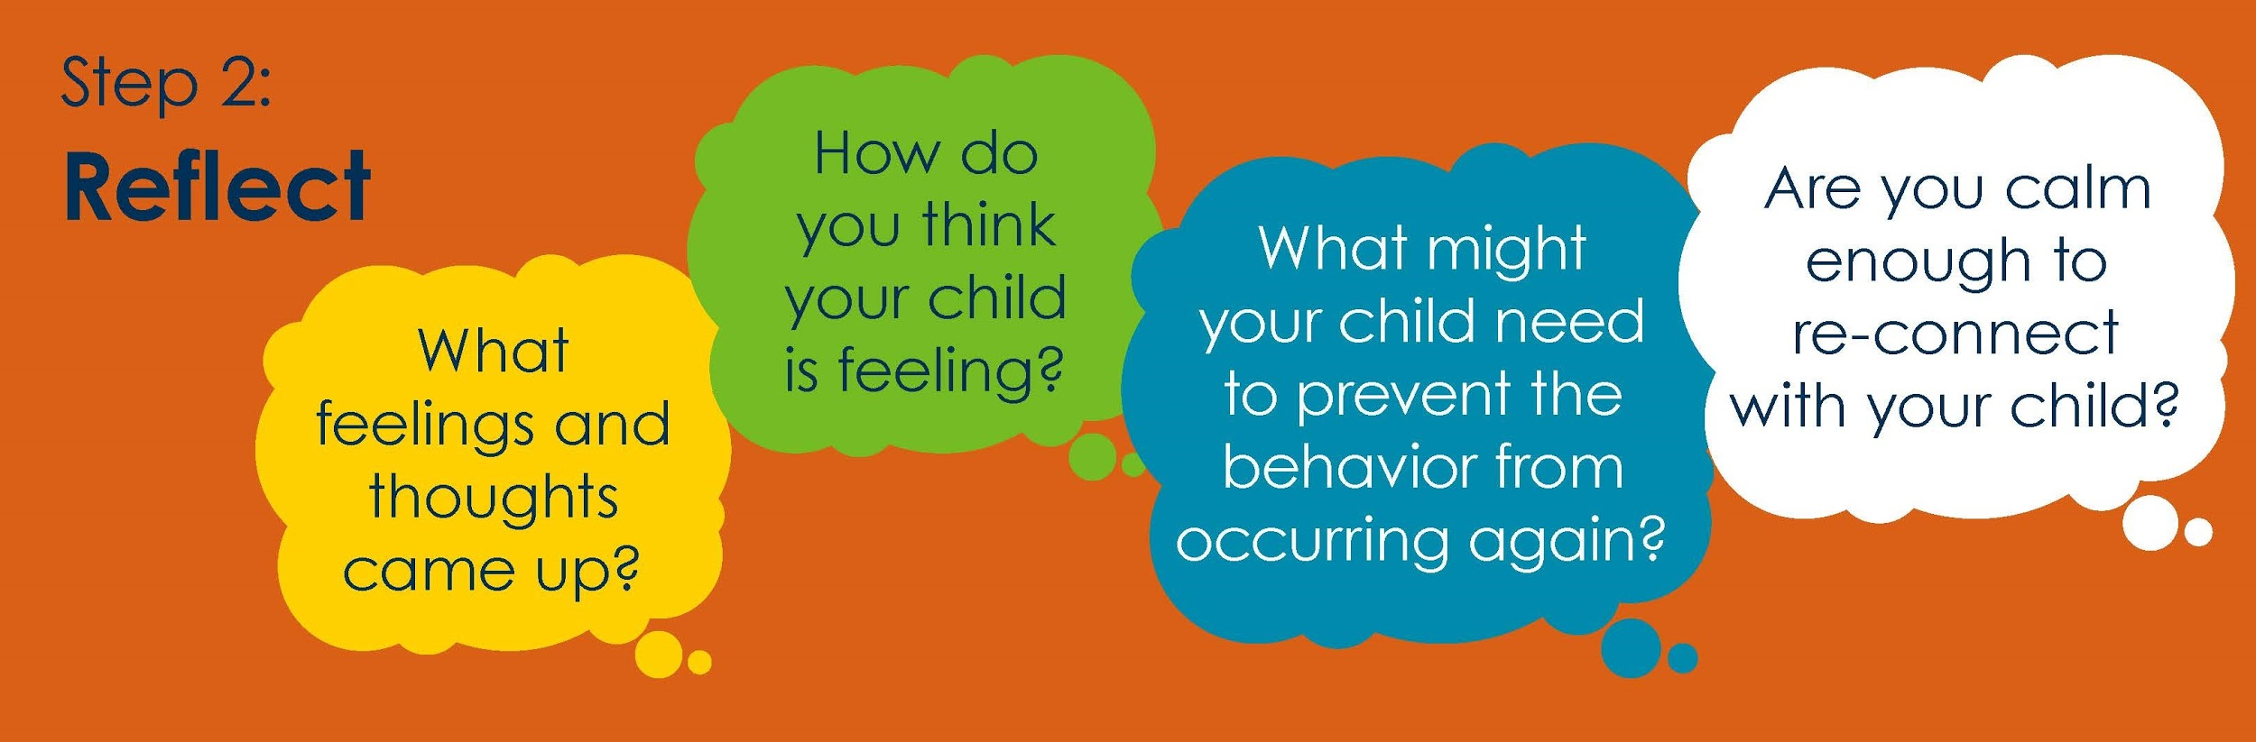

Slide 26
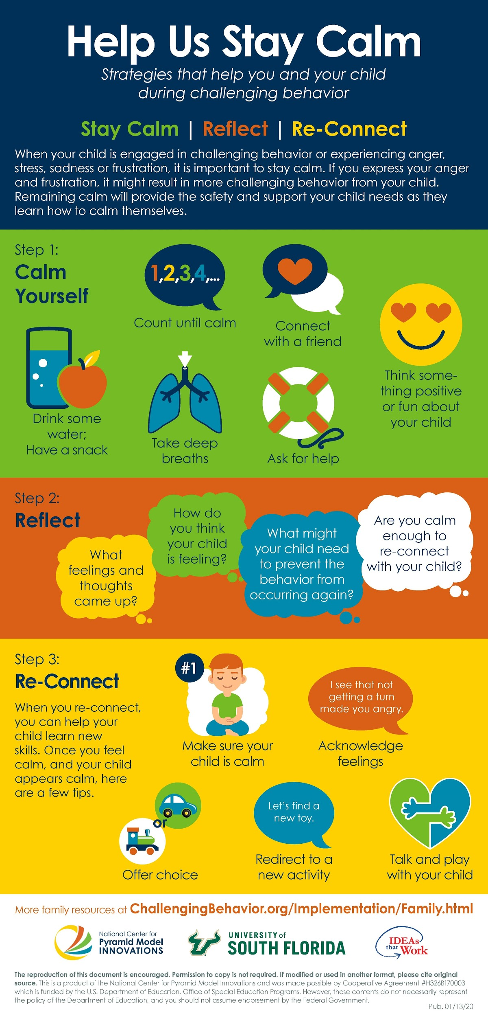

Slide 27
Middle and High School
Tim Conway, MA, MEd, LPC - Parent, Educator, & Clinician
Director of Counseling, Lakeland Regional High School
Geta Vogel EdSp
Consultant, NJPSA/FEA

Slide 28
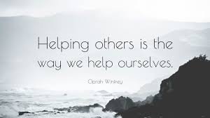
Emotional Solutions
Model self-care
  Make sure to take breaks for yourself (put your mask on first).
Model a calm environment
  This will help your children process the changes.
Take time to talk about COVID-19
  Share information so they understand based on their developmental age.
  Some youth prefer to draw, write, or act their frustrations.

Slide 29

Emotional Solutions
Turn a negative into a positive!
  Create a family project to thank first responders on the internet, posters, etc…
  Create a video “class” or “family” chat so our kids can see their friends.
Mindfulness activities, individually or as a family.
  Mindful eating
  Mindful breathing
  Mindful walking
  Mindful visualization
Notes:
Developing regular connections with family and friends can create normalcy and that everything is ok.

Slide 30

Adolescent Responses to Stress
Behaviors that challenge adults: What pushes your buttons?
Sleeping and eating problems
Agitation
Increase in conflicts
Physical complaints
Poor concentration

Slide 31

Organization
Create a structured learning environment at home.
  Set time and places for children to do their work.
Help your younger (and maybe older) children to organize their tasks so they don’t get overwhelmed.
Keep a “normal” routine.
  Get a good night's sleep!
  Healthy diet and family meals.
  Build family “exercise” or “play” time.

Slide 32
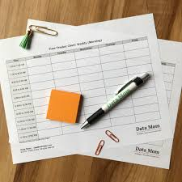
Scheduling Issues
Create a structured schedule for the family
Sharing space
Sharing technology
Break times
Sharing parent attention/help

Slide 33
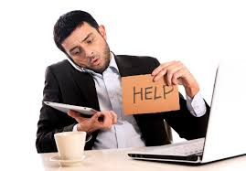
Technology Issues
No computer or WiFi is available
Do not learn well via the computer
Do not have the supports needed at home (e.g., disability)
Internet crashed
Troubleshooting computer issues (e.g., video not working)

Slide 34

Solutions to Technology Issues
Ask your school district if there is a computer you can borrow.
  Perhaps even a WiFi router or free WiFi in your community
  Can work be sent home in paper or other accommodations (e.g., disability).
Do not learn well via the computer
  Help them to create structure (e.g., task chart).
  Schedule timed breaks.
Sounds funny, but restarting the computer can help.
Youtube is a good resource to fix minor issues (e.g., video not working).

Slide 35

Who can I ask for help??
Ask your school for help
  Administrators
  Teachers
  School Counselor
  Case Manager (for students with an Individualized Education Plan)
Ask your child or family and friends for help
Look up activities and other resources in this PPT or online
Call a mental health counselor
Notes:
Use reputable sources for information (e.g., NJSCA, NASP)

Slide 36

Get Back to Your Normal?
Draw
Run/Walk
Fishing
Have a catch
Happy hour
Sit outside
Garden
Whatever floats your boat!!!
Notes:
Lots of these can be family activities or even create opportunities to teach your kids new skills, link learning from the classroom, exercise, family time, etc...

Slide 37
Resources
Talking to Children About COVID-19 (Coronavirus) A Parent Resource
Khan Academy (academic self-help videos)
Common Sense Media (apps, ideas, videos for kids & parents)
Coronavirus Information Link

Slide 38
Take Away from our Webinar
Multi-Age Recommendations
Identify and Build Sources of Strength
Establish Self Care for Children
  Create a daily schedule for each child with their name(s) and adhere to them. Remember, routine is important.
  Take care of yourself and your children by eating healthy, getting daily exercise and a good night’s sleep.
  Socialization is important for everyone.
Stay calm. Children react to the way you express yourself.
Filter daily media. Overexposure is overwhelming!

Slide 39
Sustaining Mental Health:
Children need to feel safe and to be able to express themselves.
Be Responsive.
Listen to your children.
Teach them things that they can do to keep safe. (Wash hands while singing the alphabet song, at least 20 seconds).
Keep in mind that stress can cause multiple issues in children, such as:
  Poor eating and sleep patterns.
  Potential increase in combative behavior, “pushing buttons”, increase in conflicts.

Slide 40
Handling Misbehavior...
Calm yourself. Take big breaths, call a friend, count, drink water.
Reflect. Gather your thoughts, think about how your child is feeling, think about what needs to be done to prevent recurrence.
Reconnect - Make sure your child is calm, offer choices, acknowledge feelings, talk/play with child.
Emotional Solutions...
Model self-care. (put on mask, first)
Turn the negative into a positive. This is a good opportunity for family projects.

Slide 41
Who Can I Ask for Help?
School personnel, a school counselor, or case manager.
A religious leader.
Family or Friends.
Professional Counselor.

Slide 42


Remember
It is important to and Equally important to stay Strong!

Slide 43
Webinar Presentation Team
Cathy Lindenbaum- President, NJPTA
Patricia Wright, Executive Director NJPSA and President FEA
Jim Lukach, Executive Director of NJ School Counselors Association;
George Scott, Traumatic Loss Coalition
Kaitlin Mulcahy, Montclair State University, Center for Autism & Early Childhood Mental Health
Tim Conway, Director of Counseling for Lakeland Regional HS
Geta Vogel, , Consultant, NJPSA/FEA

Slide 44
Development Team
Cathy Lindenbaum, President, New Jersey PTA
Robert Acerra, President-Elect, New Jersey PTA
Patricia Wright, FEA President and Executive Director of New Jersey Principals and Supervisors Association
Donna McInerney, CEO Foundation for Educational Administration
Jim Lukach, Executive Director of NJ School Counselors Association;
Tim Conway, Director of Counseling for Lakeland Regional HS;
Sue Coyle, Middlesex County Traumatic Loss Coalition Coordinator (continued on next slide)

Slide 45
Development Team, continued
George Scott, Statewide Resource Coordinator, Traumatic Loss Coalition
Kaitlin Mulcahy, Montclair State University, Center for Autism & Early Childhood Mental Health
Geta Vogel, NJPSA/FEA Consultant
David Nash, Esq., LEGAL ONE Director, Foundation for Educational Administration
Muriel Rand, Professor, New Jersey City University
Mary Beth Currie, Coordinator of Special Projects, Foundation for Educational Administration, Team Leader

